Slide 1
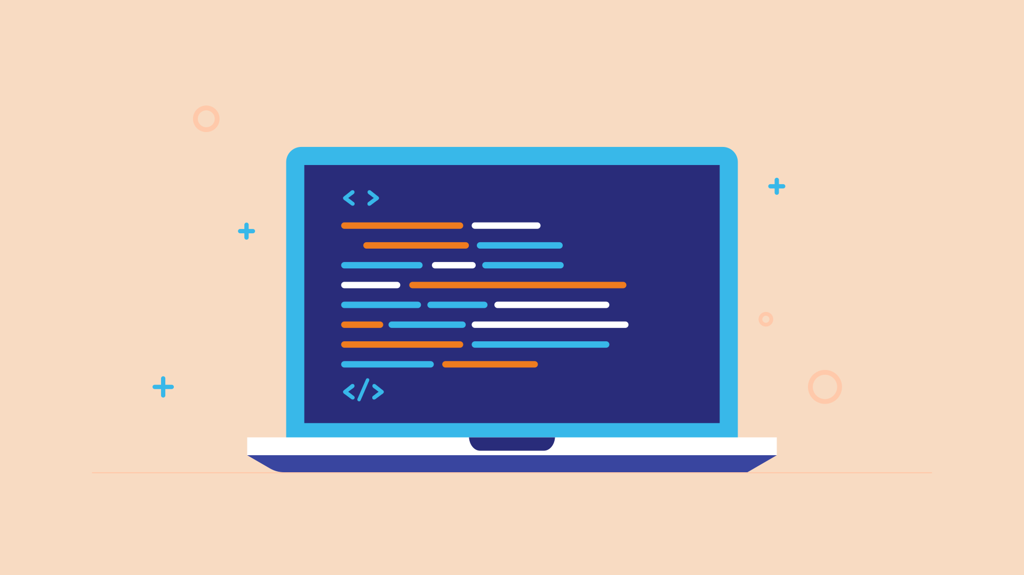
Which Programmer To be?
All about programming

Slide 2

Types of Programmers
[Data Scientists]
[WEB Programmers]
[Game Developers]
[App Developers]
[Software Engineers]

Slide 3

DATA SCIENCE

Slide 4

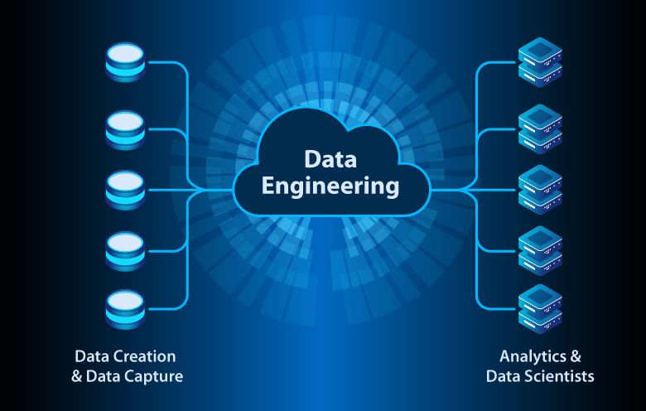
Data engineering
Data engineers are responsible for designing, maintaining, and optimizing data infrastructure for data collection, management, transformation, and access. They are in charge of creating pipelines that convert raw data into usable formats for data scientists and other data consumers to utilize.

Slide 5
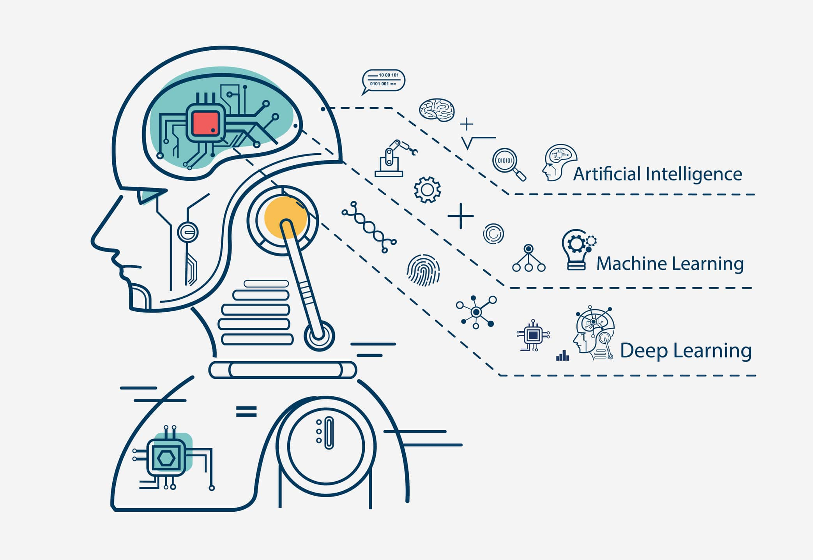
Machine Learning
Machine learning (ML) is a field devoted to understanding and building methods that let machines "learn" – that is, methods that leverage data to improve computer performance on some set of tasks. Machine learning algorithms build a model based on sample data, known as training data, in order to make predictions or decisions without being explicitly programmed to do so.

Slide 6


Programming
Programming refers to a technological process for telling a computer which tasks to perform in order to solve problems. For example: when you develop computer software, artificial intelligences, neural networks and etc. For programming in general we use python, and libraries like matplotlib, opencv, numpy.

Slide 7
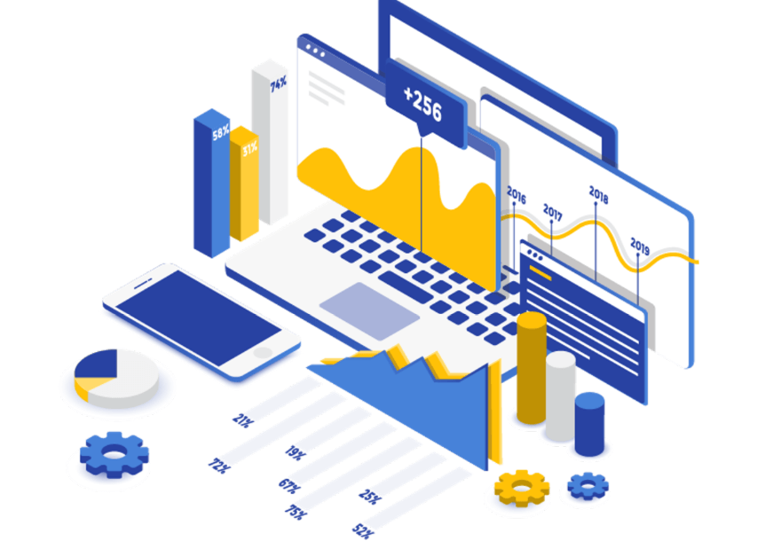
Analytics
In short, data analytics is the broad field of using data and tools to provide insights to make informed decisions. Terms like data analysis, data science and business analytics are often used interchangeably as industry buzz words.

Slide 8
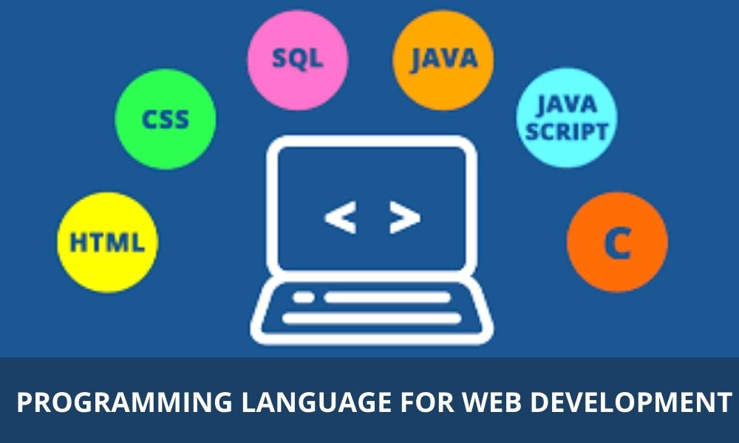
WEB PROGRAMMERS

Slide 9
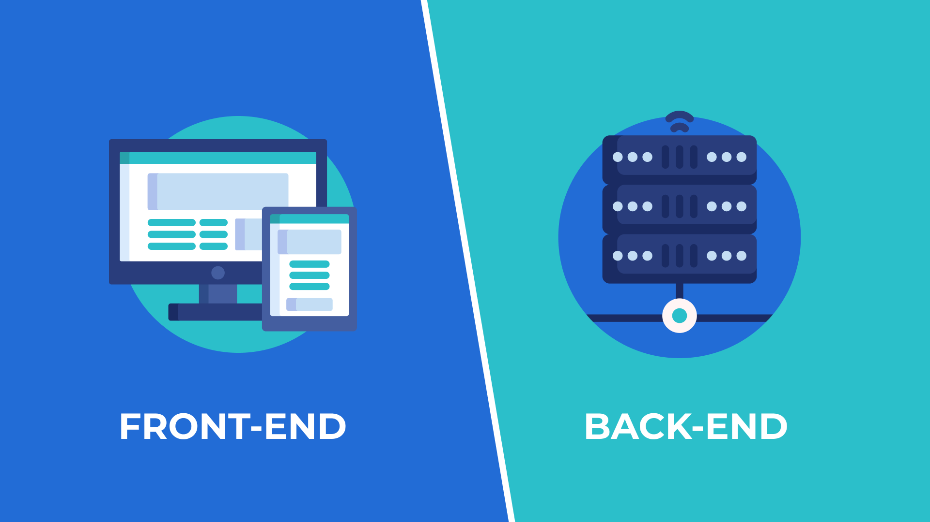
Types Of Web Programmers

Slide 10


Backend Programmers
The back end refers to parts of a computer application or a program's code that allow it to operate and that cannot be accessed by a user. Most data and operating syntax are stored and accessed in the back end of a computer system. Typically the code is comprised of one or more programming languages. We use languages: Python, HTML, CSS

Slide 11

Frontend Programmers
What is this frontend?
What is Frontend? The frontend is everything a user sees and interacts with when they click on a link or type in a web address. The web address is also known as at URL, or Uniform Resource Locator, and it tells what webpage should load and appear in your browser. It is the client-side part of a web application. We use languages: Javascript, HTML, CSS

Slide 12
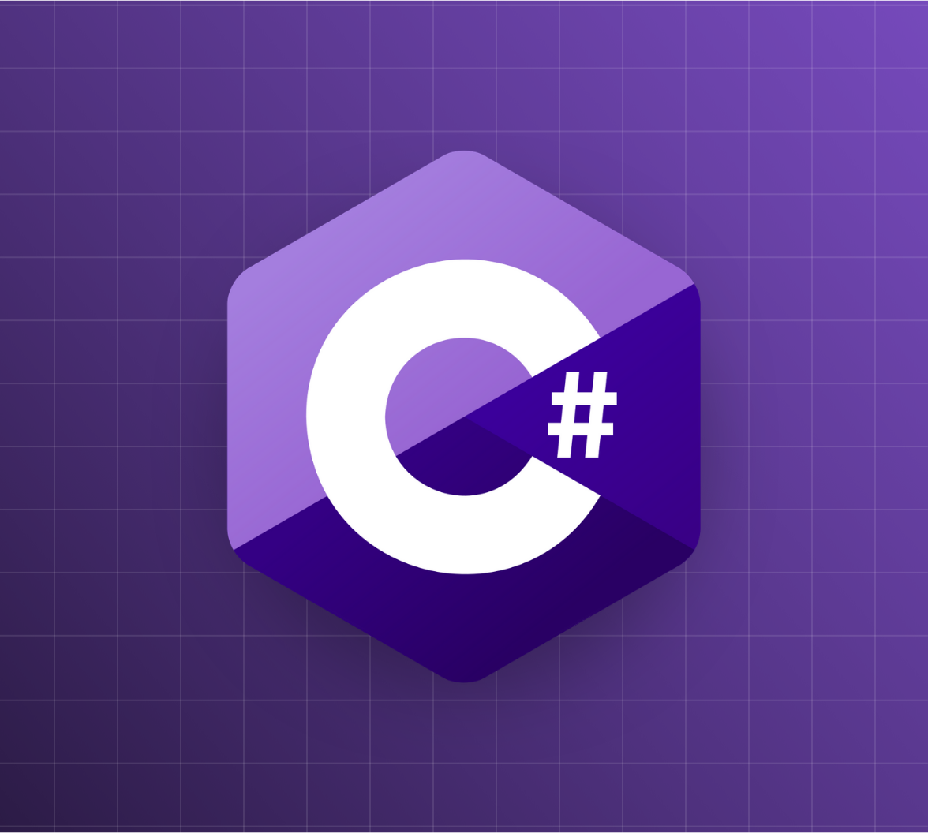
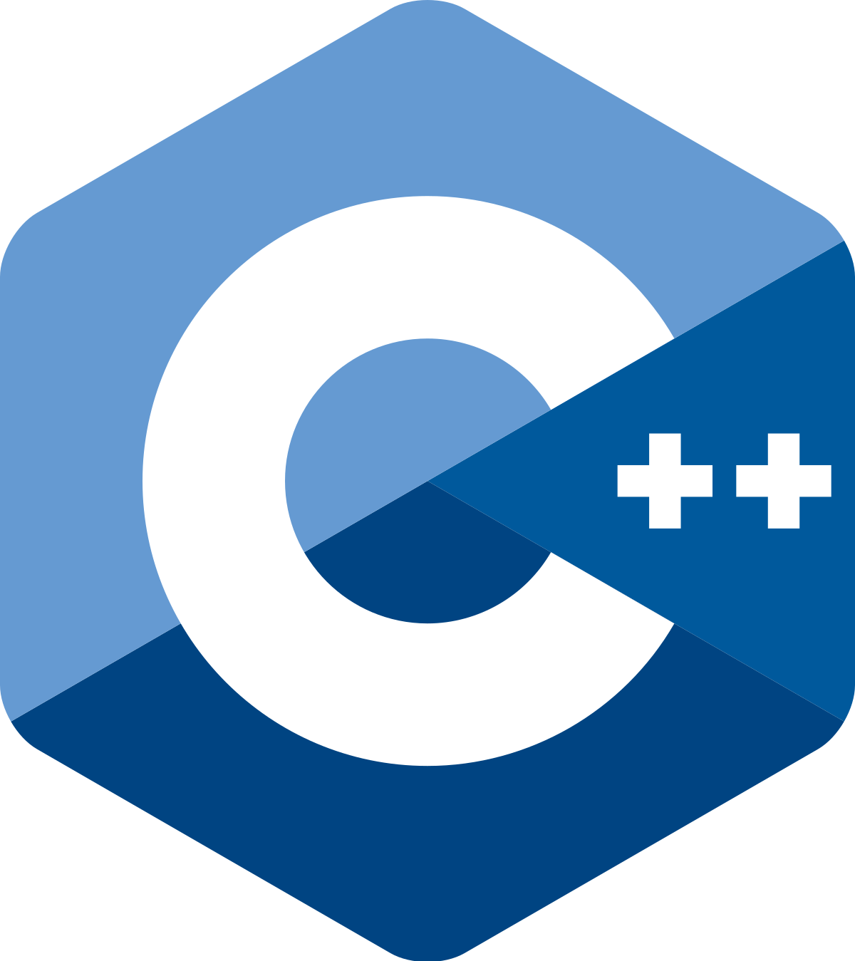

GAME DEVELOPERS
Who creates games in different devices. PC, laptop, phone and etc.
They are uses: Unity Engine Program(alternative Unreal Engine), C++ or C#. Video game developers help transform games from a concept to a playable reality. They do this by coding visual elements, programming features, and testing iterations until a game is ready for market. If you love video games and enjoy working with computers, a career in video game development can be immensely rewarding.

Slide 13




APP DEVELOPERS
A Mobile Developer – also known as a mobile app developer or an app developer – is someone who designs, develops, and implements mobile applications. They are responsible for the development of these software applications in line with the appropriate mobile platforms. They uses technologies like: Android Studio, Kotlin, Java, Flutter

Slide 14
SOFTWARE ENGINEERS
Software engineering is the branch of computer science that deals with the design, development, testing, and maintenance of software applications. Software engineers apply engineering principles and knowledge of programming languages to build software solutions for end users. They uses a lot of Programming Languages, and build software

Slide 15
Thanks For Watching! Follow us in Social Media:
YouTube✅
Instagram📸
Telegram🌌
Subscribe

